Slide 1
Burp Suite
Dheepshika Raghunathan
Sai MADHAV RAJU Goriparthi

Slide 2
Introduction
Tool for Web Application Penetration Testing
Works on HTTP/HTTPS communication protocols
Intercepting proxy
Graphical Interface
Written in Java
Cross Platform tool

Slide 3
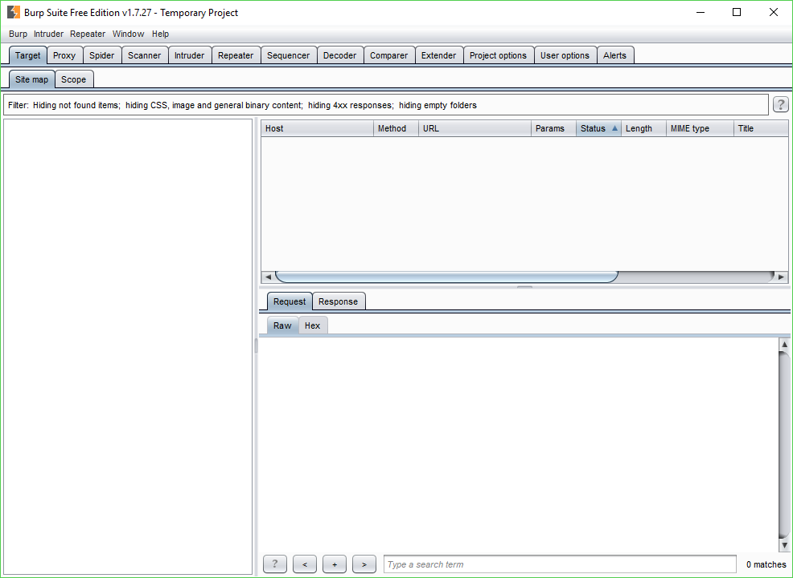
Burp Suite

Slide 4
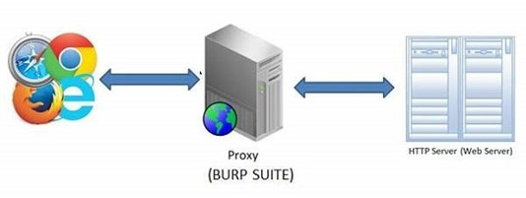
How it works

Slide 5
Tools of Burp Suite
PROXY
TARGET
SPIDER
SCANNER
INTRUDER
REPEATER
SEQUENCER
COMPARER
EXTENDER

Slide 6
Proxy
Core of Burp Suite
Intercepts all traffic going through it
Request and response details could be manipulated
Interception status can be toggled On/Off
Maintains a history of all requests and responses

Slide 7
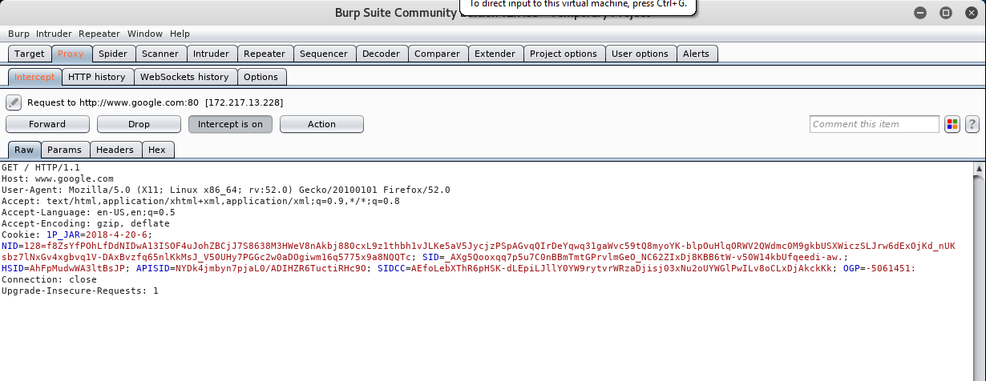
Proxy Tab

Slide 8
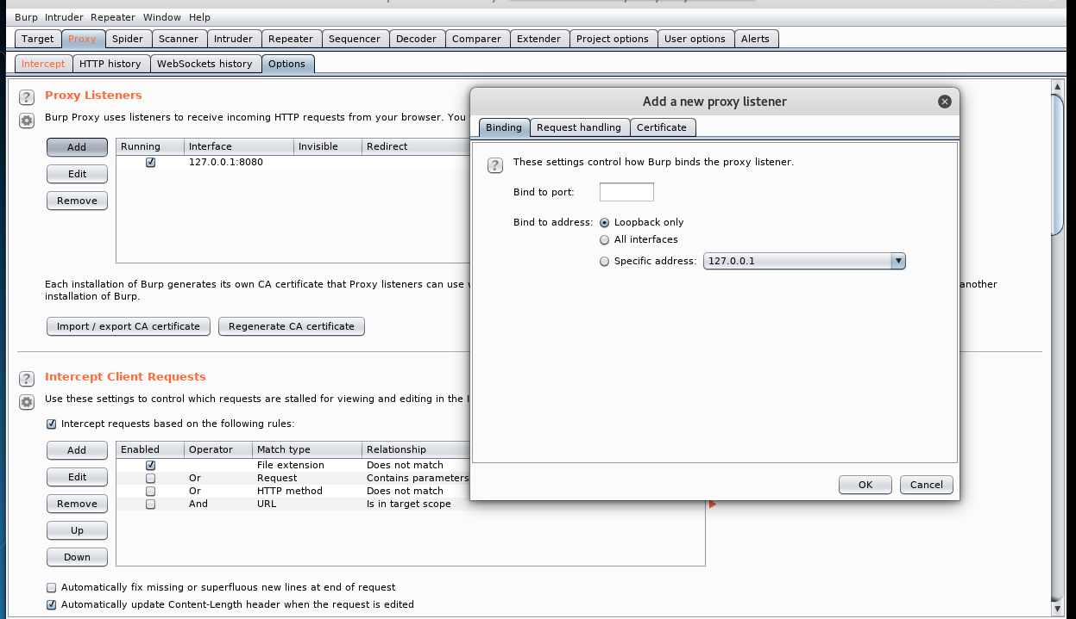
Proxy Setting Options

Slide 9
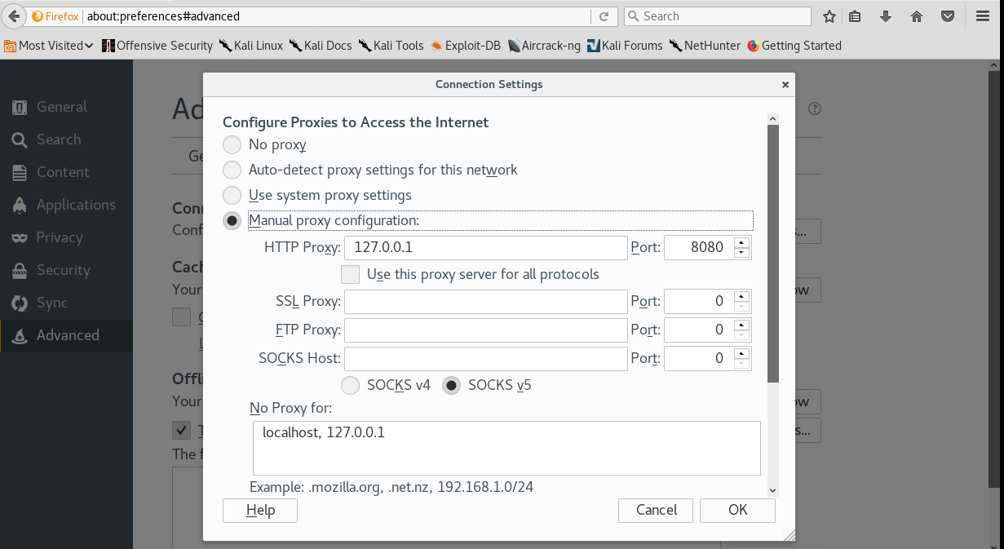
Browser Proxy Setting

Slide 10
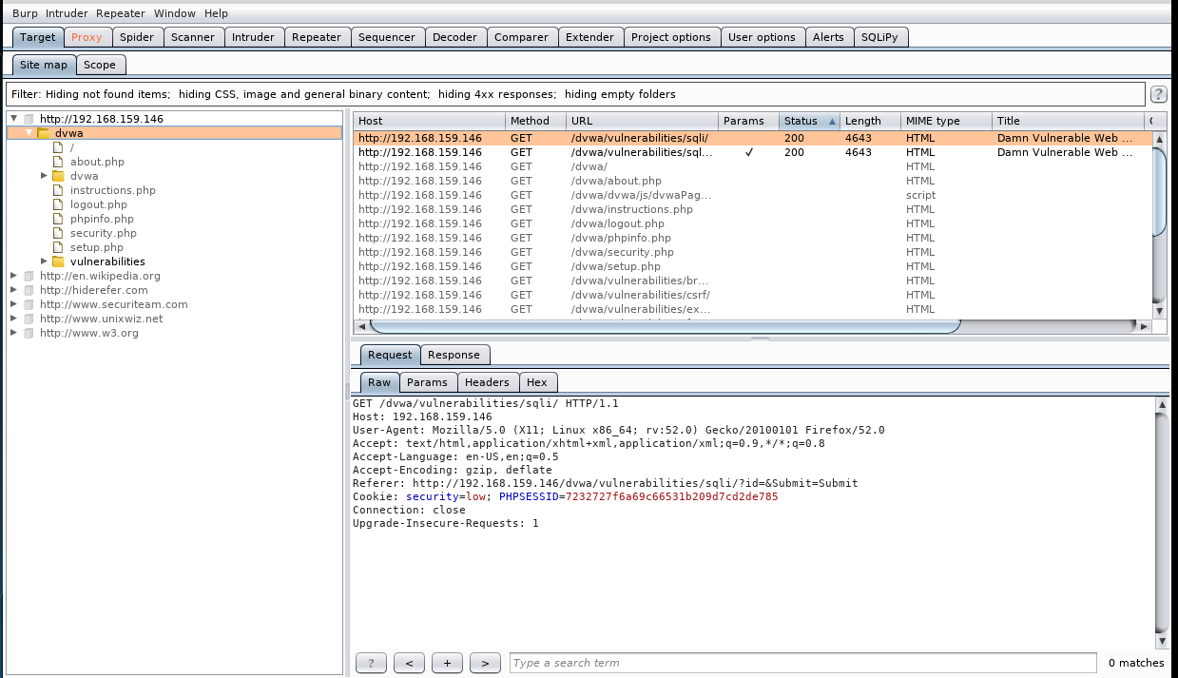
Target
This tab stores a tree of the target application

Slide 11
Spider
Used to crawl a given website
Can be used to find hidden pages and contents
Passive crawling
Submits forms automatically

Slide 12
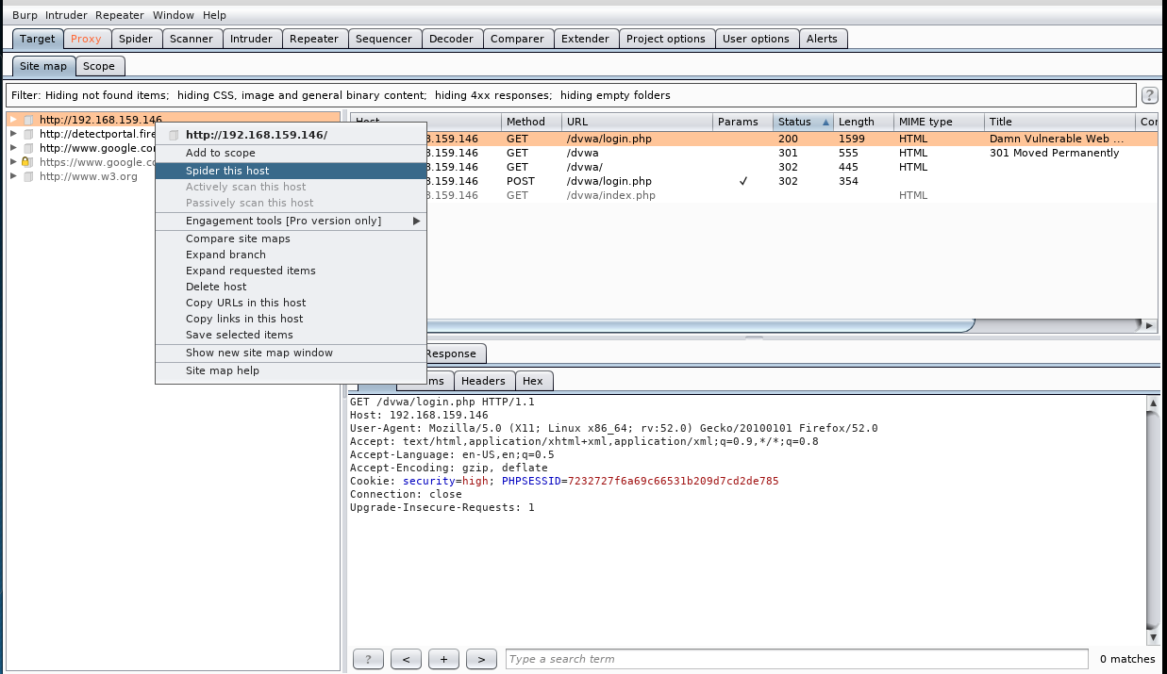
Spider

Slide 13
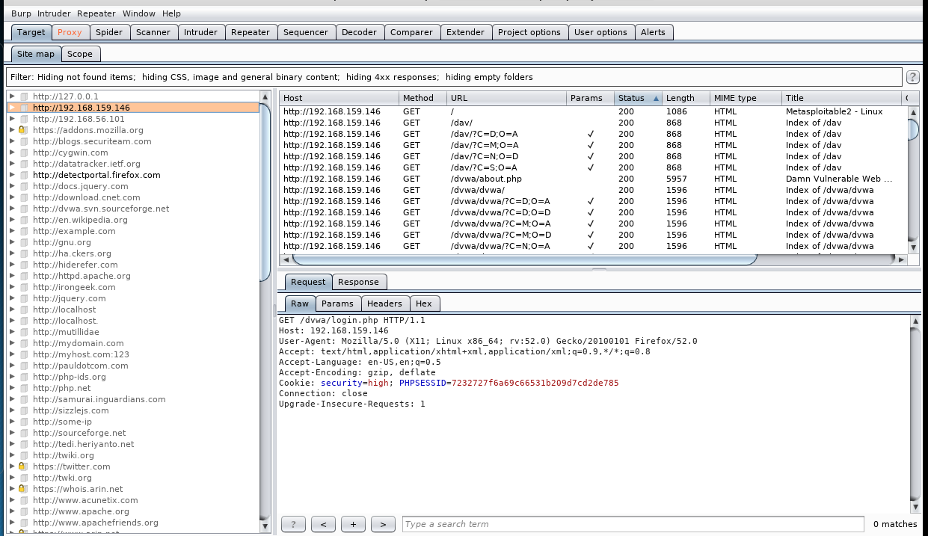
Spider

Slide 14
Intruder
Exploiting vulnerabilities
Fuzzing
Brute Forcing

Slide 15
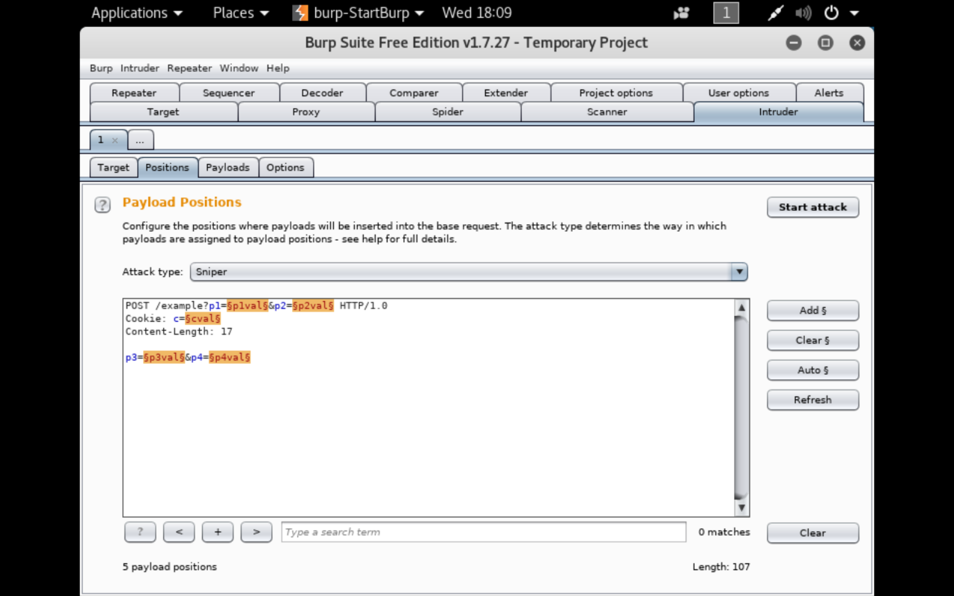
Intruder

Slide 16
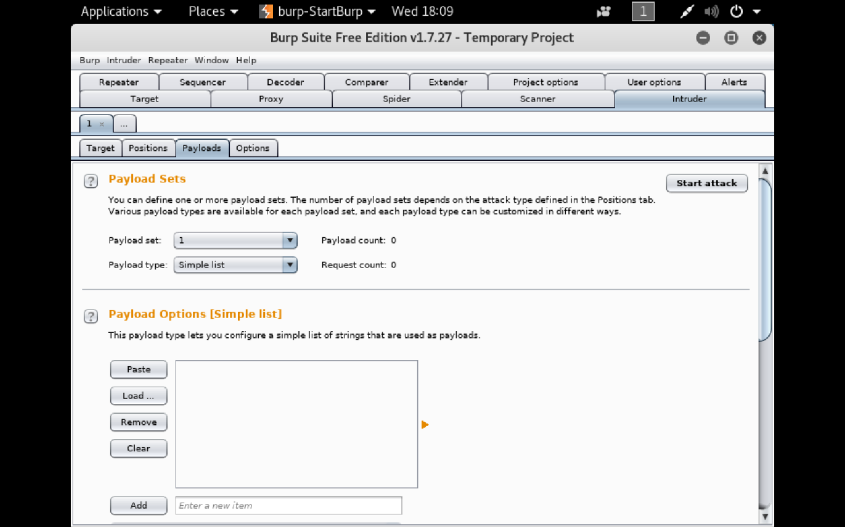
Intruder

Slide 17
Scanner
Scanner is used to scan vulnerabilities in web applications. It can perform -
Passive Scan
Active Scan
Generate the report of scan

Slide 18
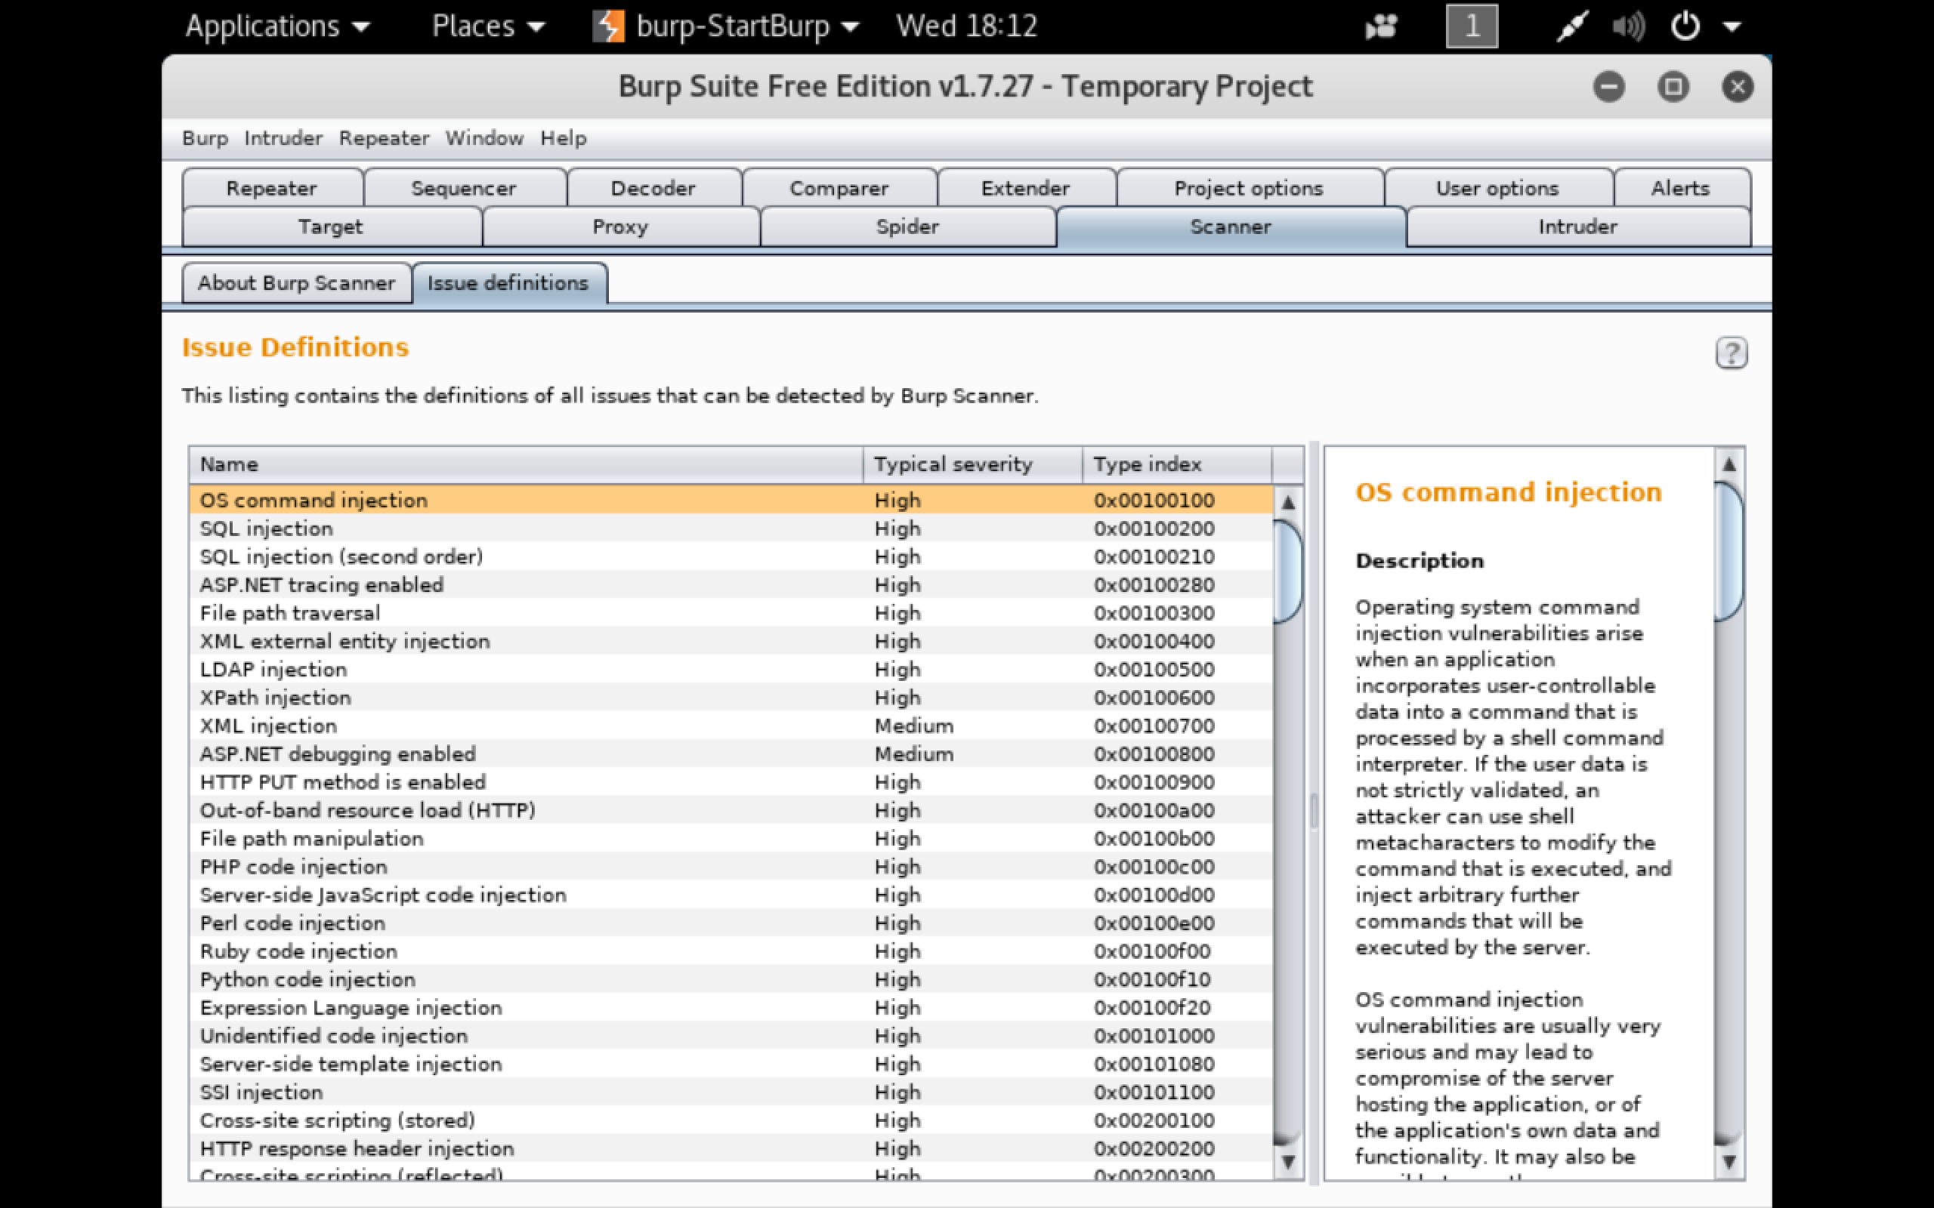
Scanner

Slide 19
Repeater
Manually manipulating and reissue the requests
Analyze the responses for each requests.
Maintaining the history of requests and responses.

Slide 20
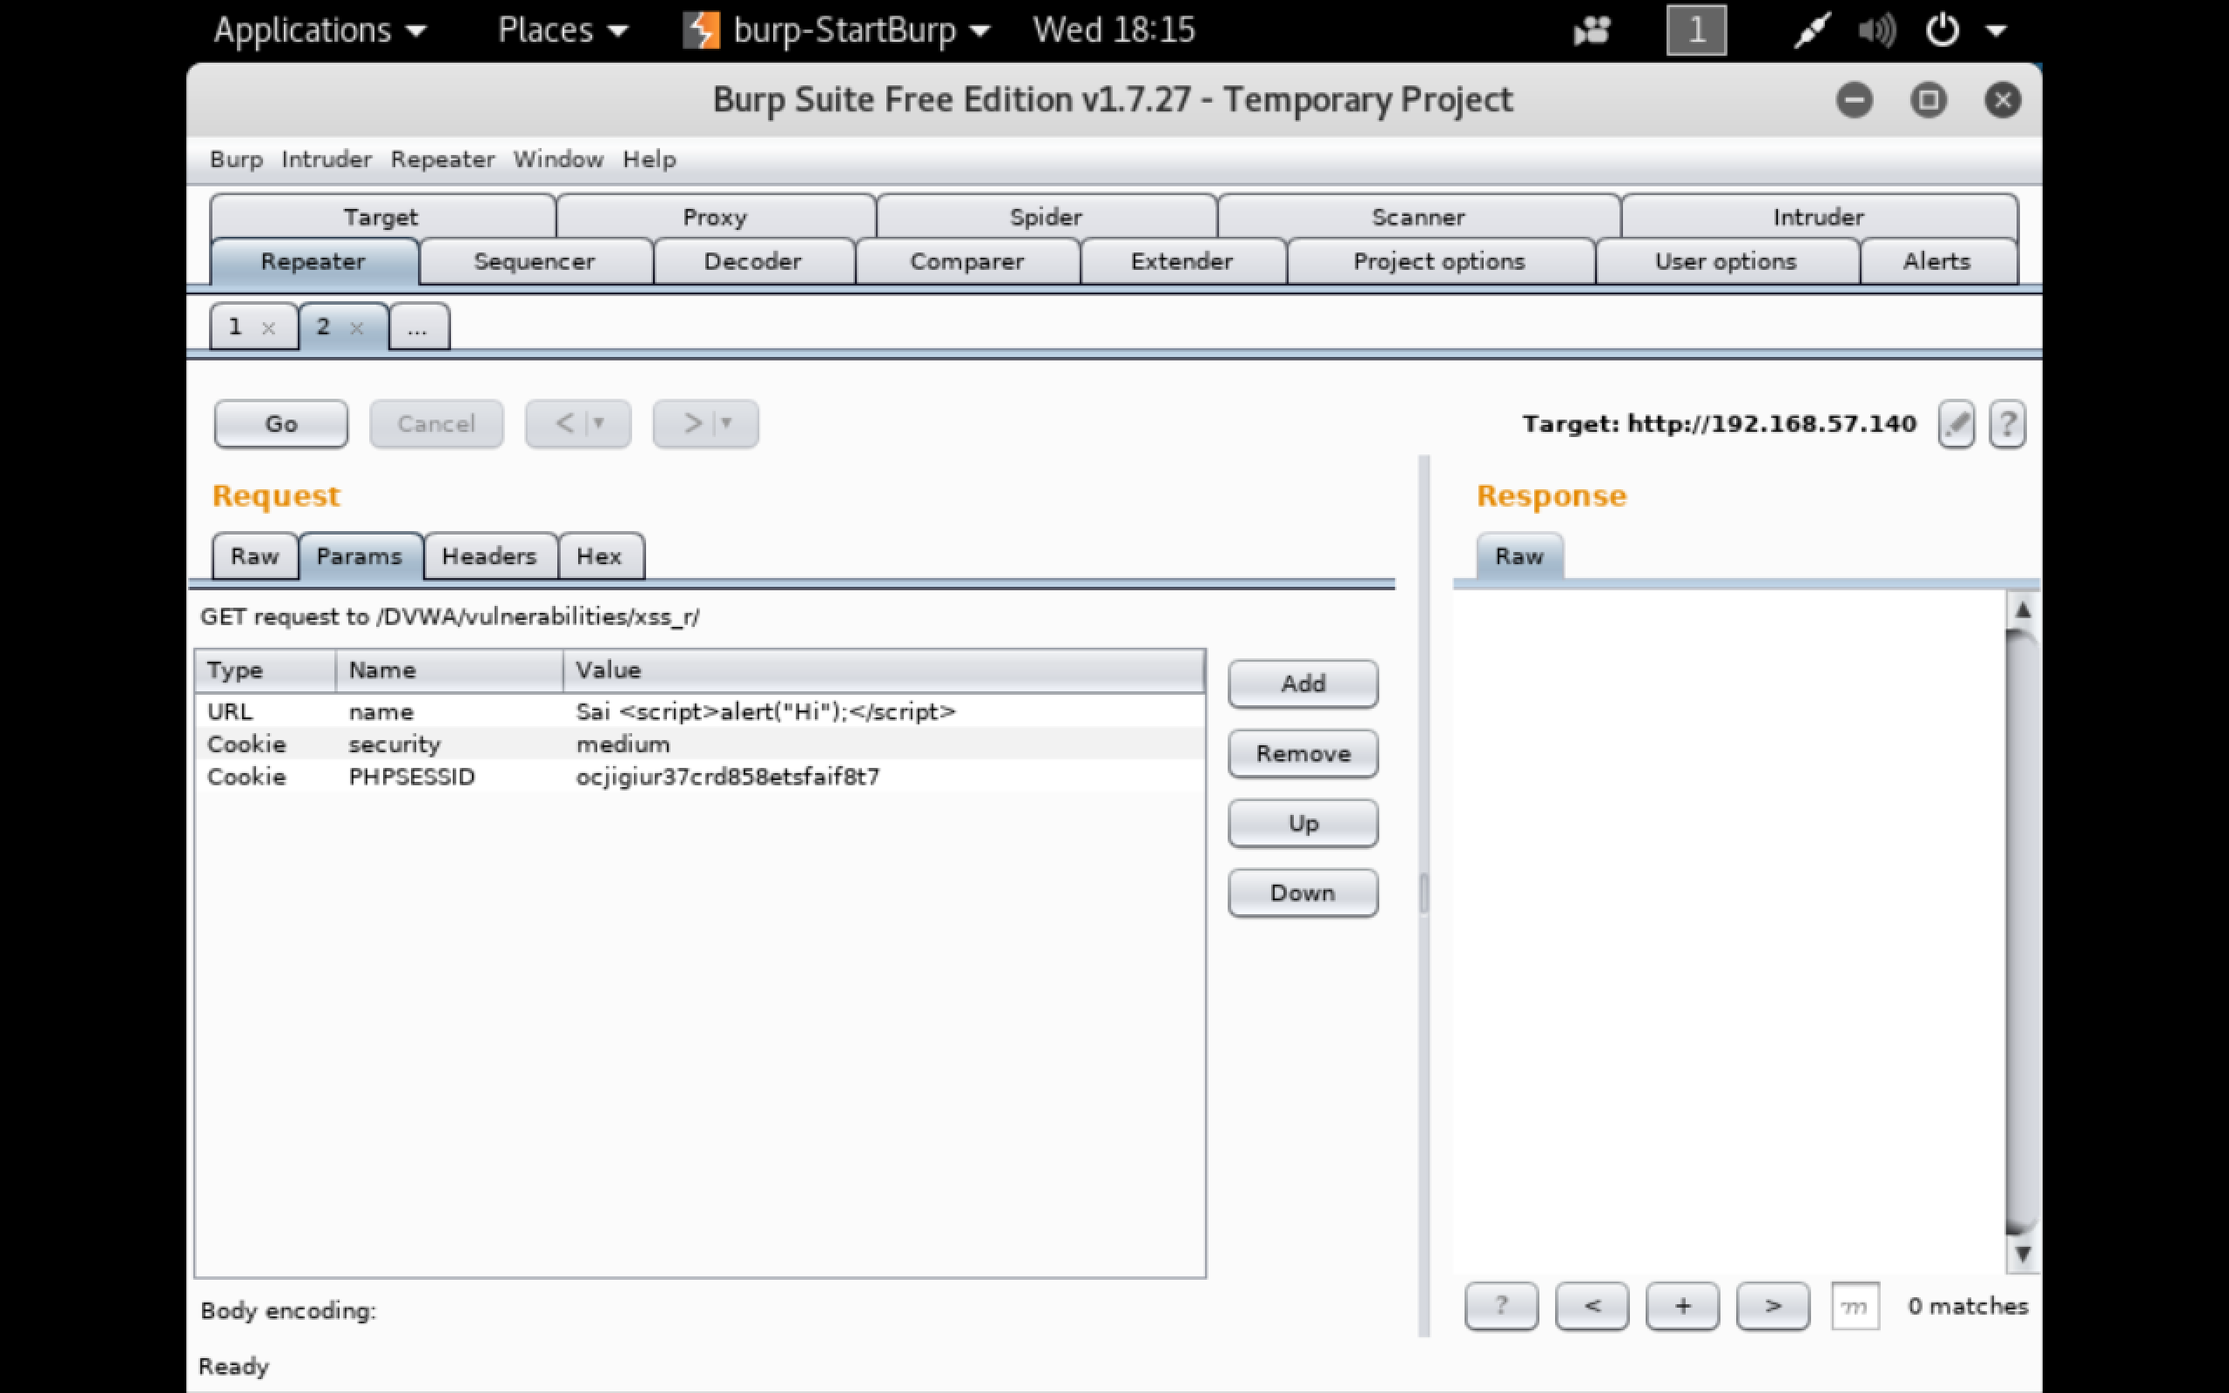
Repeater

Slide 21
Sequencer
Used for analyzing the quality of randomness
Can be used to test the unpredictable values such as password reset tokens, anti-CSRF tokens etc.

Slide 22
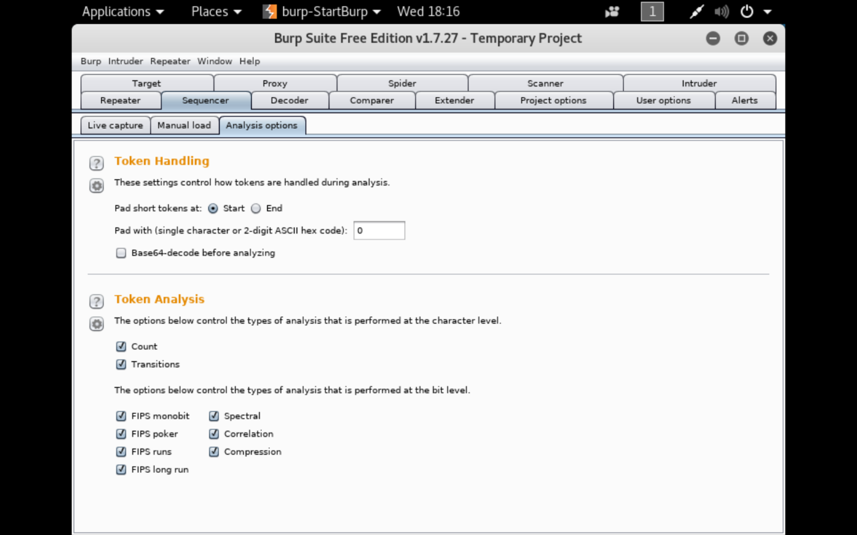
Sequencer

Slide 23
Comparer
Used to perform visual diffing between two data items.
This comes in handy when two large similar responses are to be compared.

Slide 24
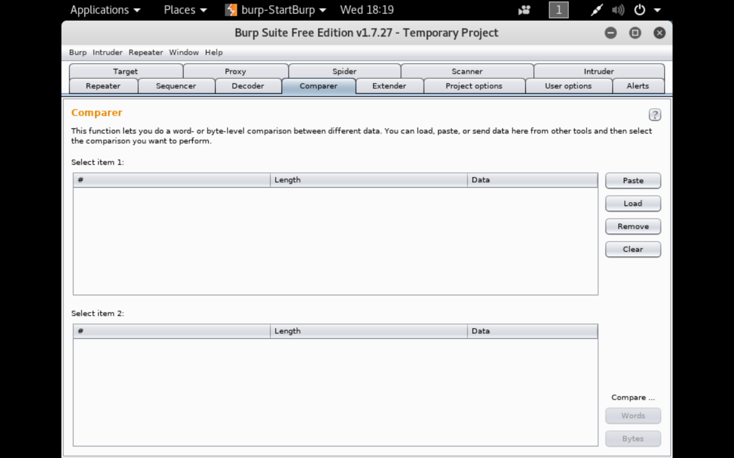
Comparer

Slide 25
Extender
It helps to extend burps functionality with other third party code.
Burp lets you use Extensions written in Java, Python and Ruby.

Slide 26
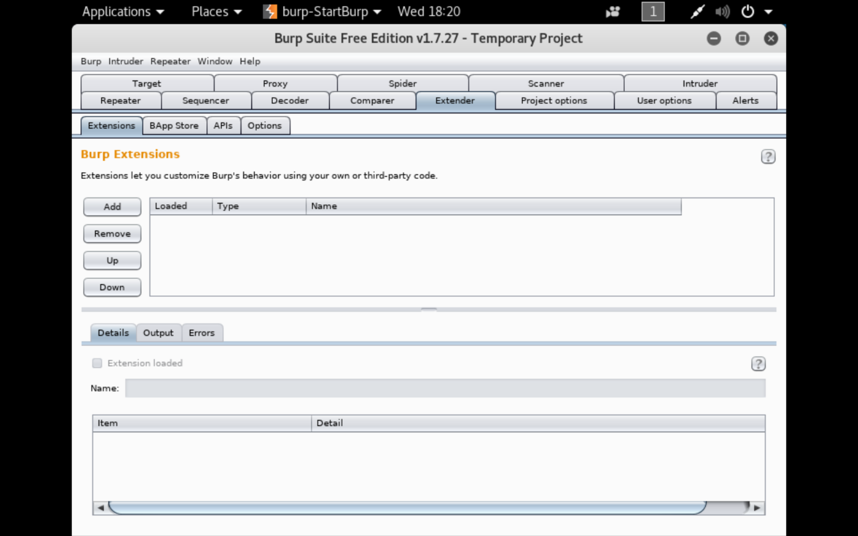
Extender

Slide 27
Use Case 1 SQL Injection using Burp Suite

Slide 28
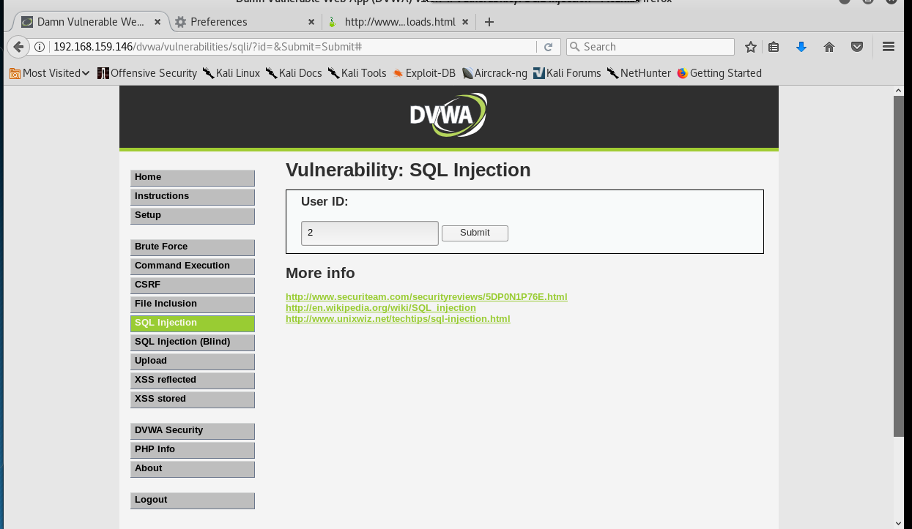
Entering a value in the field

Slide 29
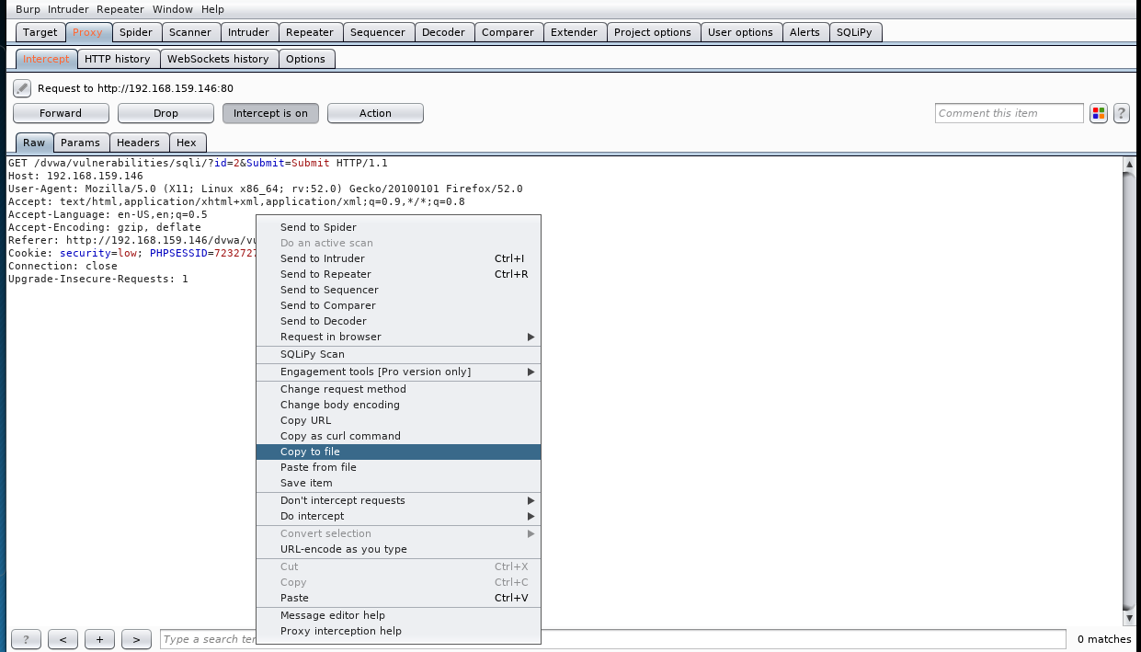
Saving the intercepted headers to a file

Slide 30
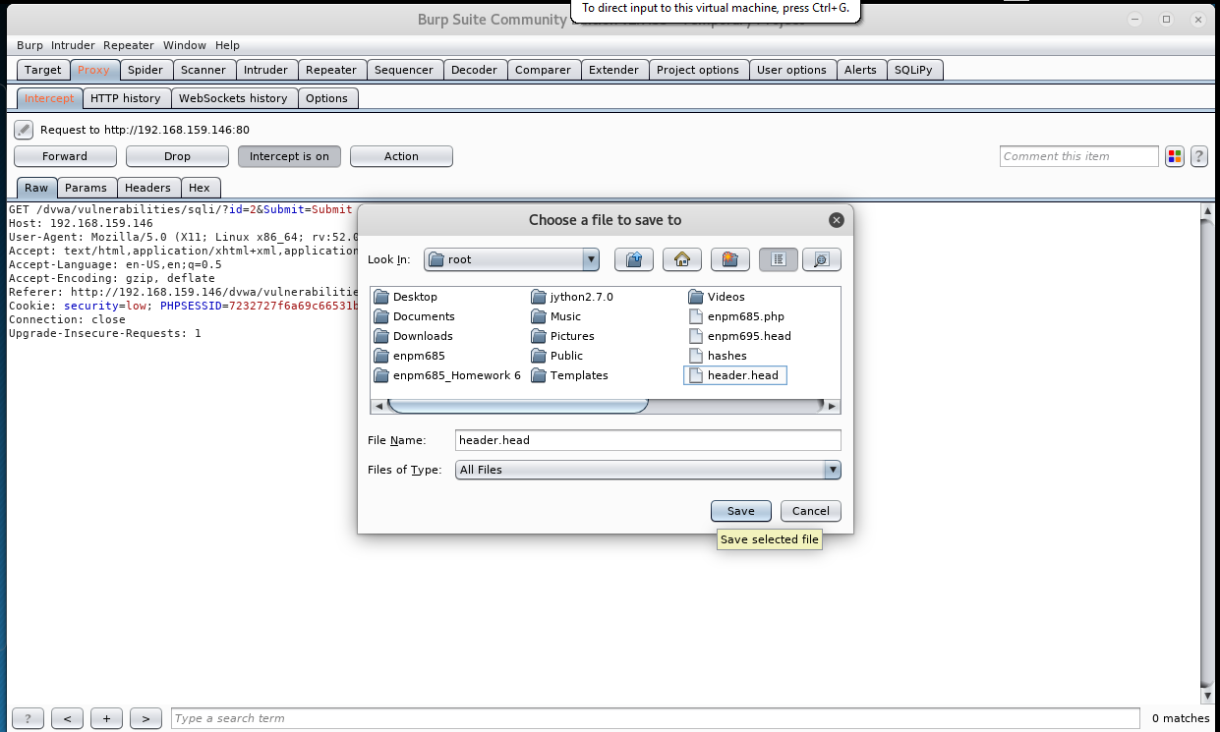
Saving the Header file

Slide 31
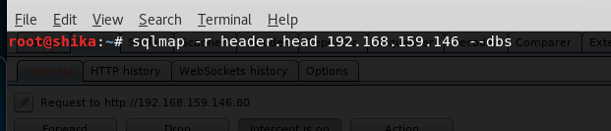
Using the extracted header in SQLMap
The –r option in SQLMap allows the user to add the header to SQL Map

Slide 32
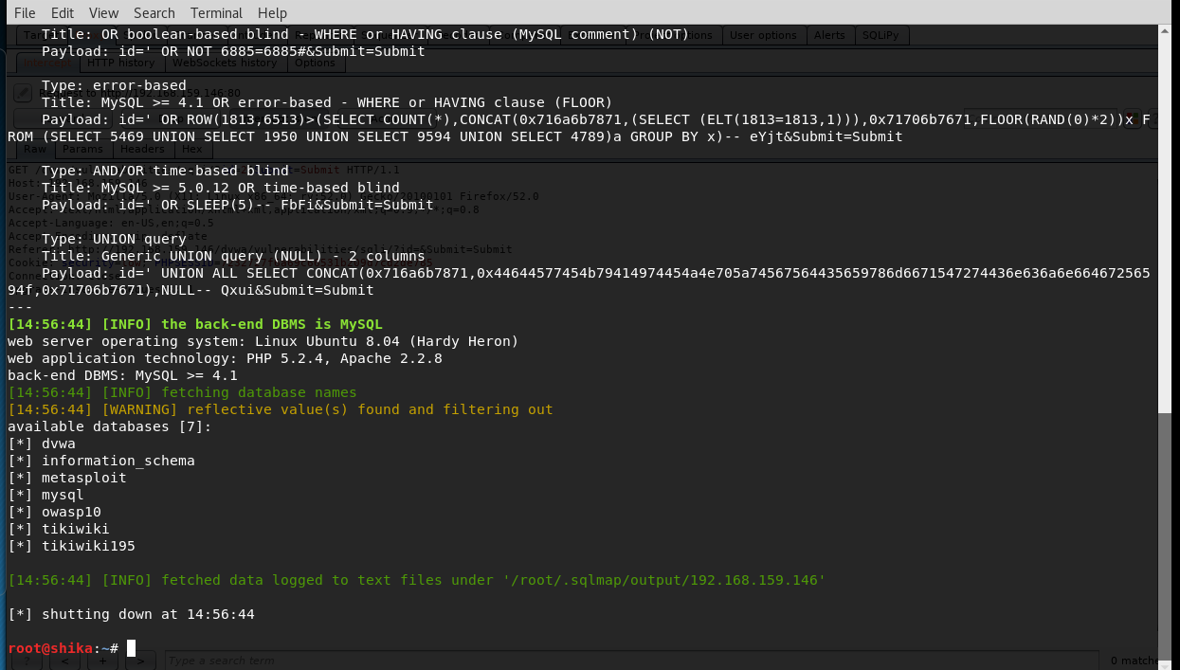
Attack is Successful

Slide 33
Use Case 2 Brute Force Attack using Burp Suite

Slide 34
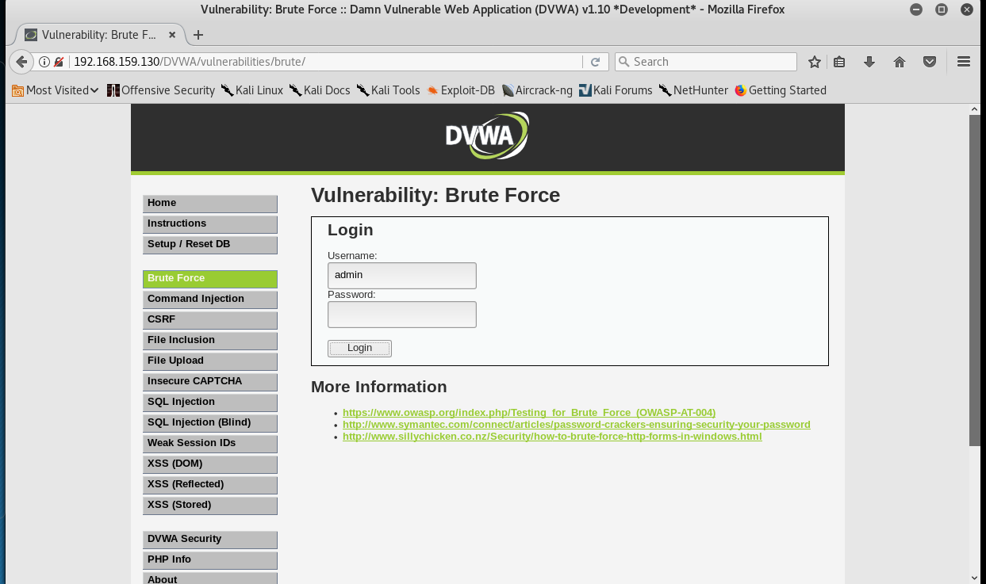
Field to be Brute Forced

Slide 35
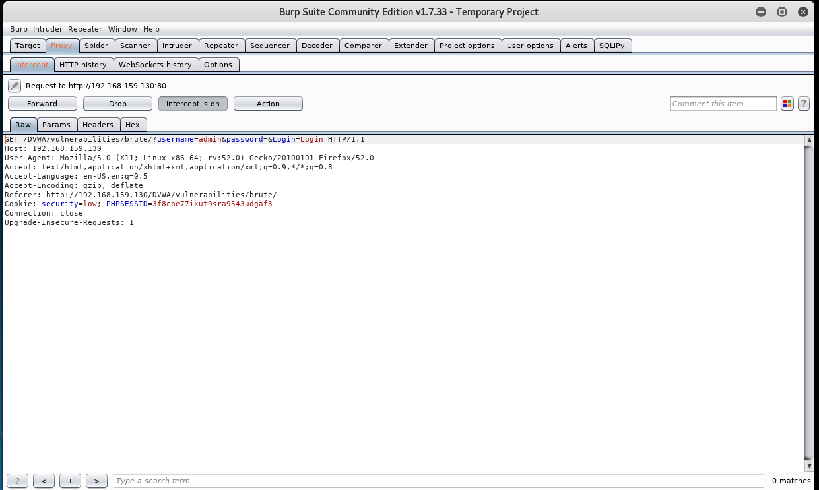
Intercepting the request

Slide 36
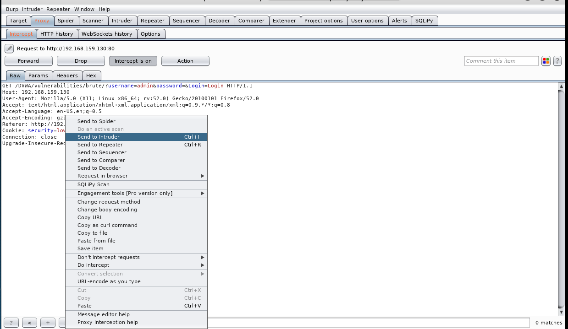
Sending the Request to Intruder

Slide 37
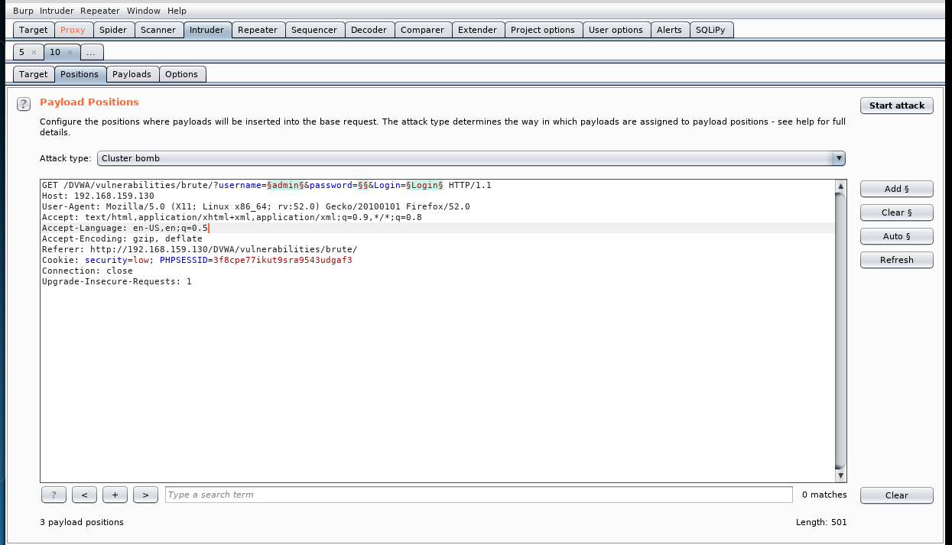
Intruder - Positions

Slide 38
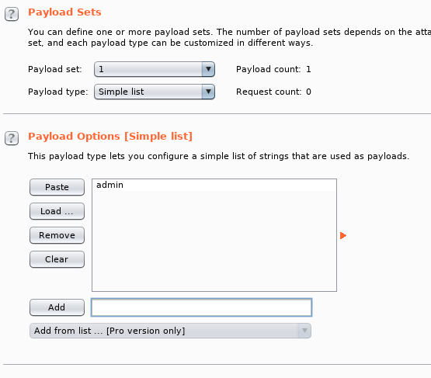
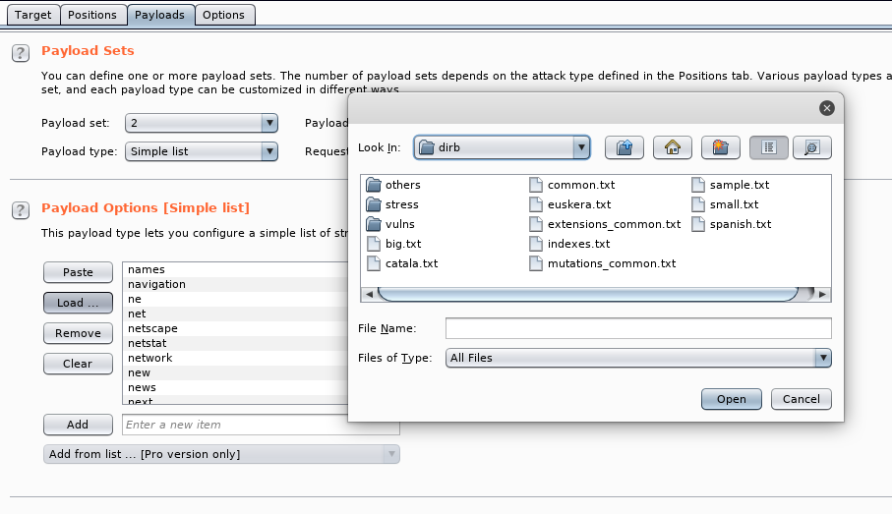
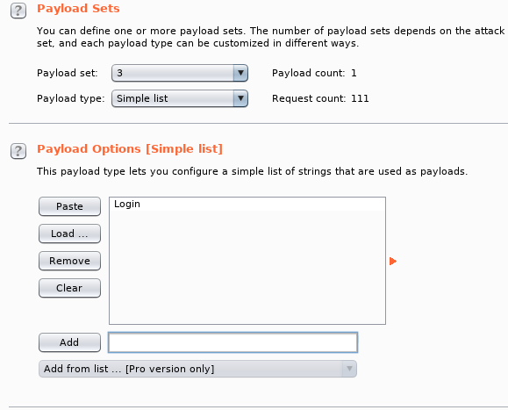
Intruder - Payload
Username
Password
Submit
Burp Suite brute forcing is slow in the Free Edition! ☹

Slide 39
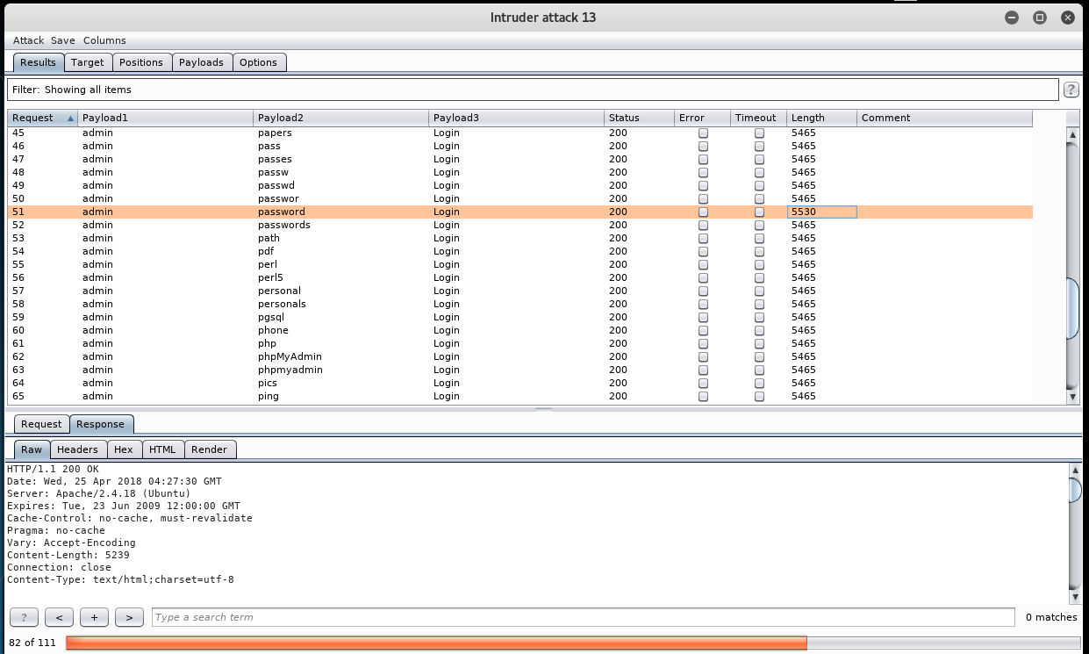
Attack is Successful!

Slide 40
Use Case 3 Cross Site Scripting (XSS)

Slide 41
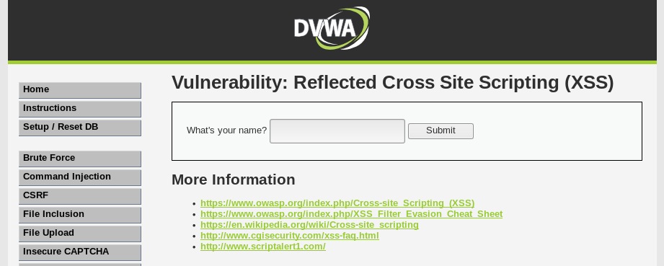
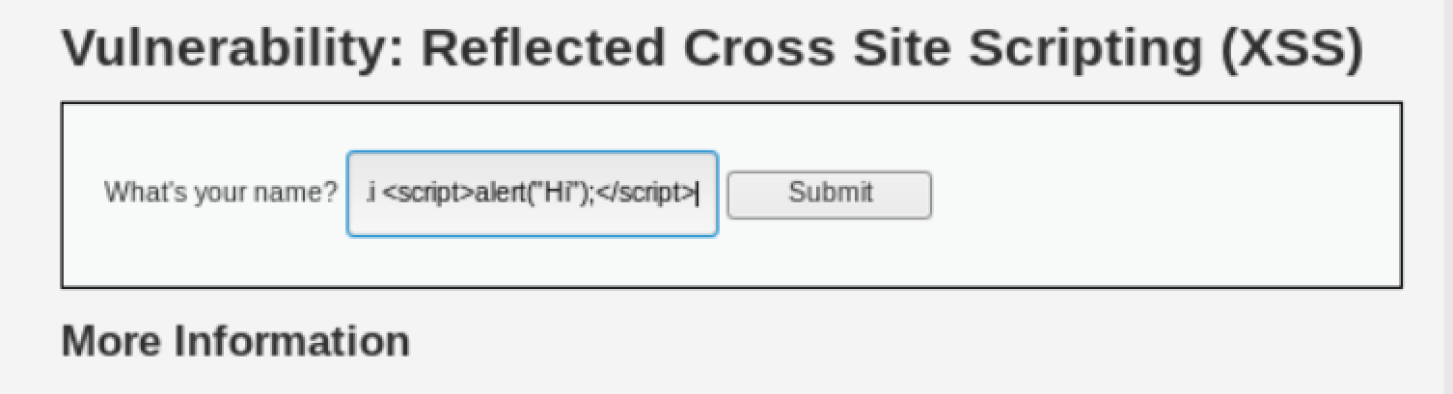
Target

Slide 42
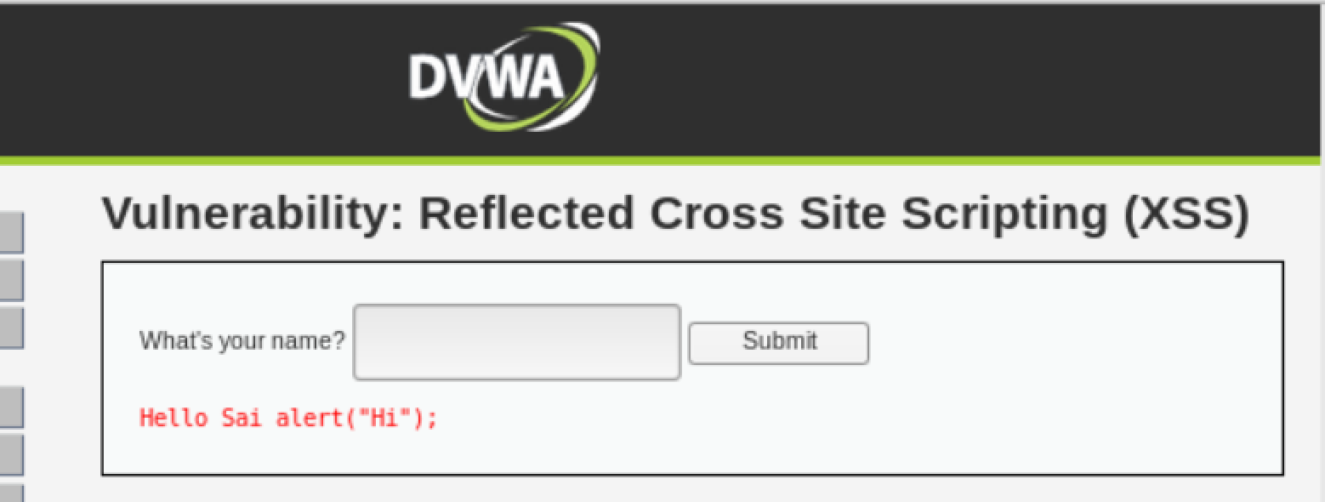
Target
DVWA did not run the entered script.

Slide 43
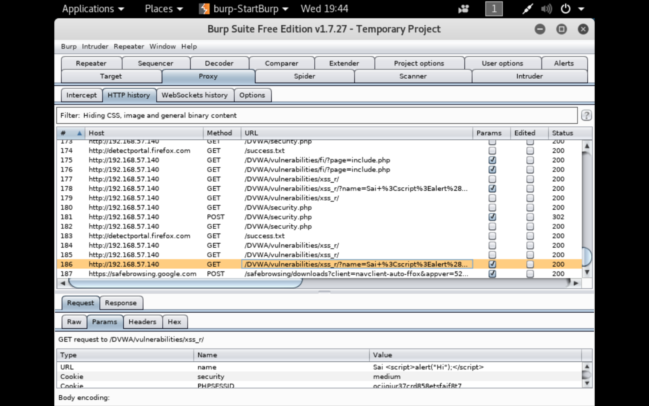
Burp Suite HTTP History
Network proxy was set up, but intercept was off

Slide 44
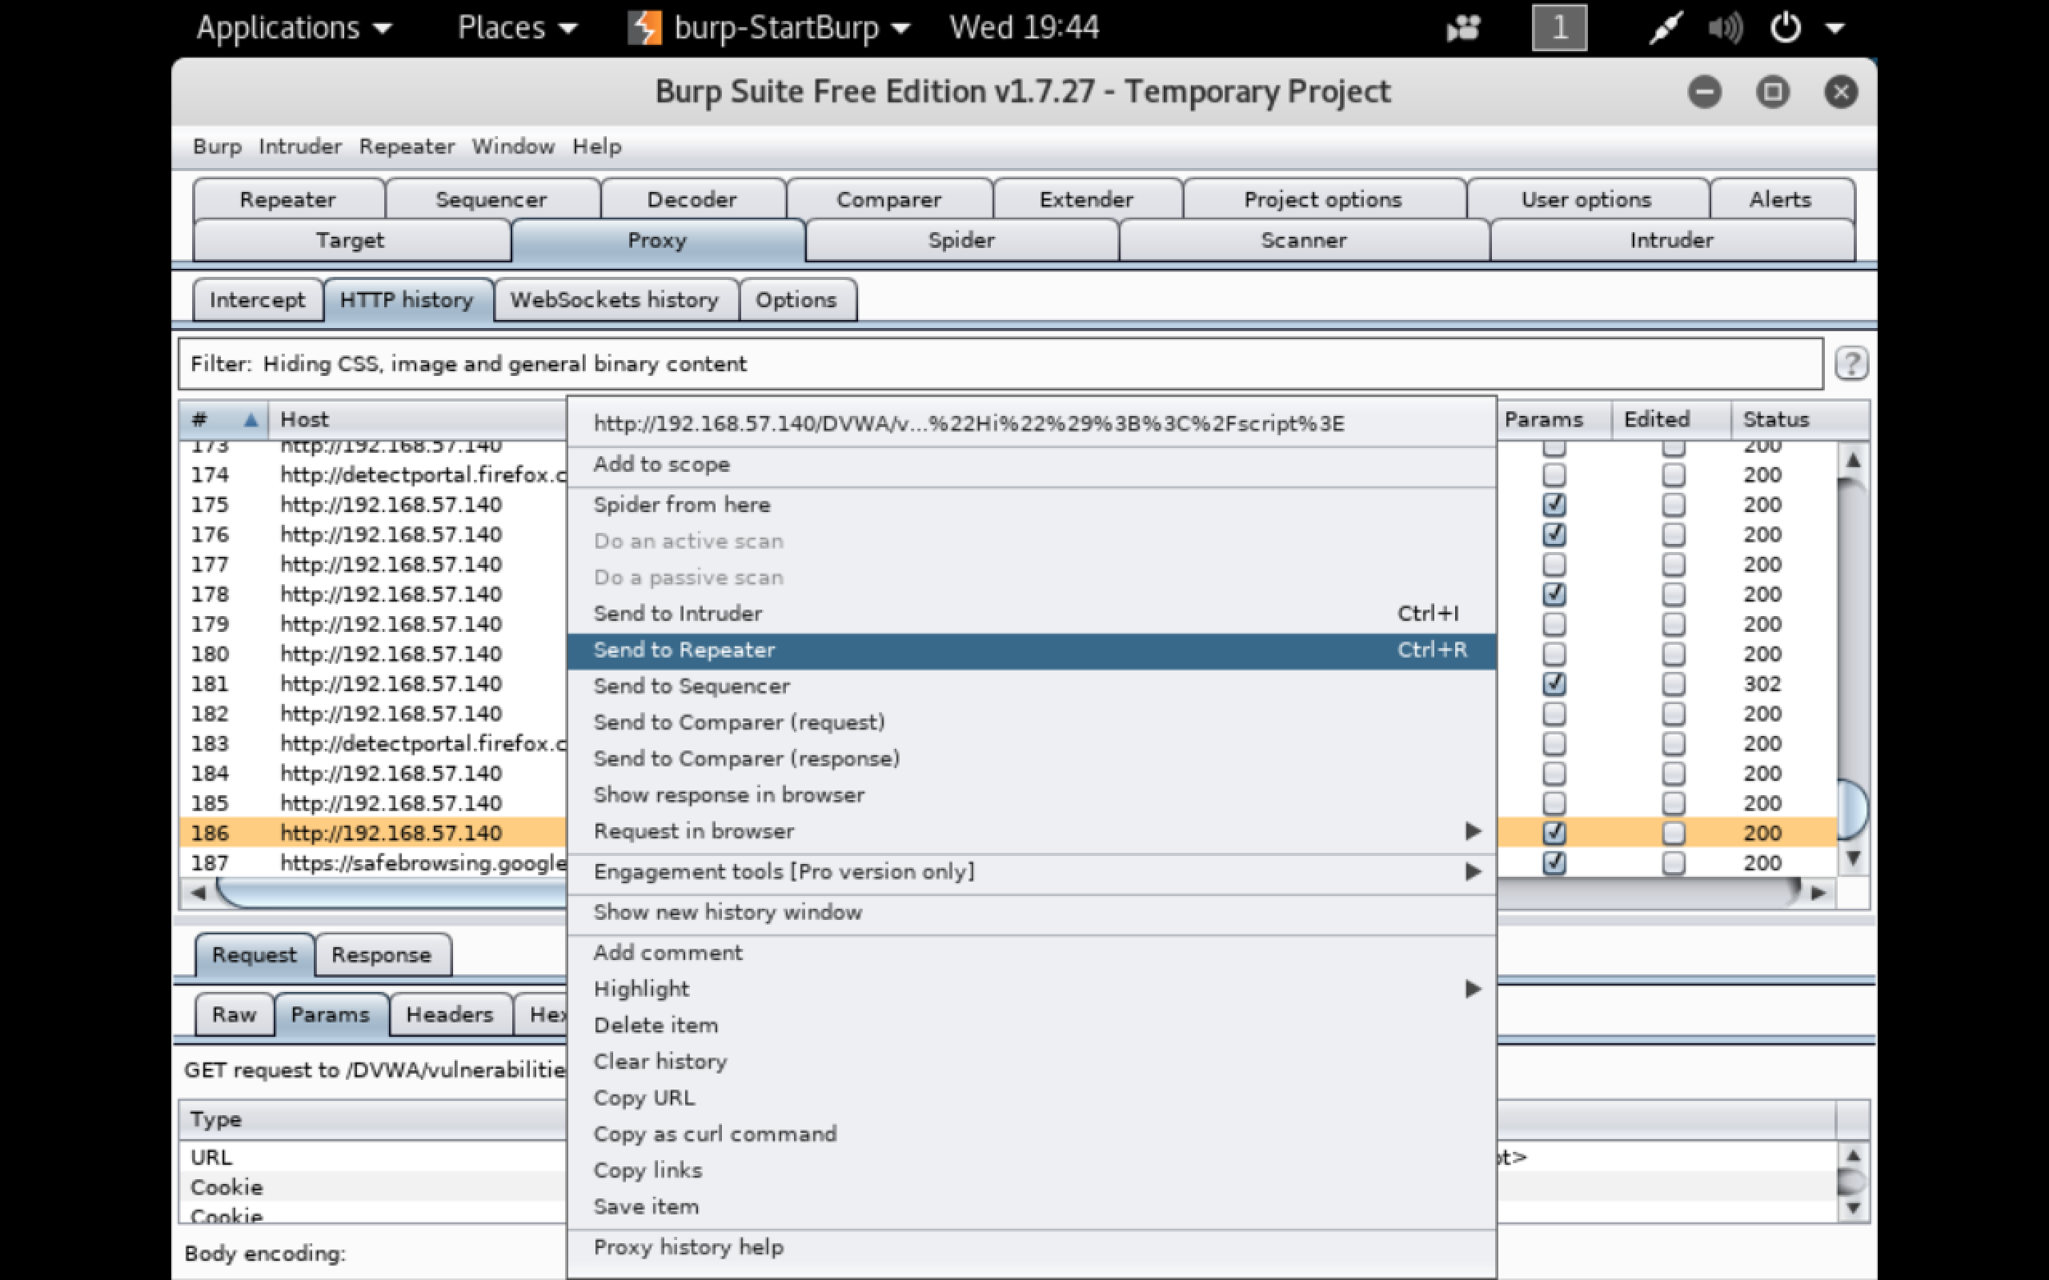
Sending Request to Repeater

Slide 45
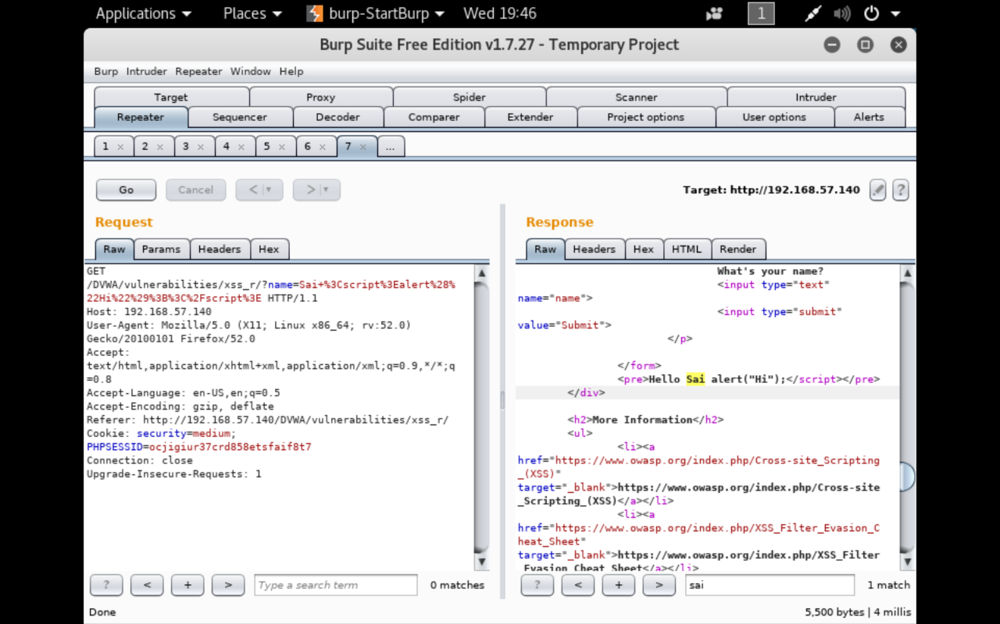
Repeater request and response

Slide 46
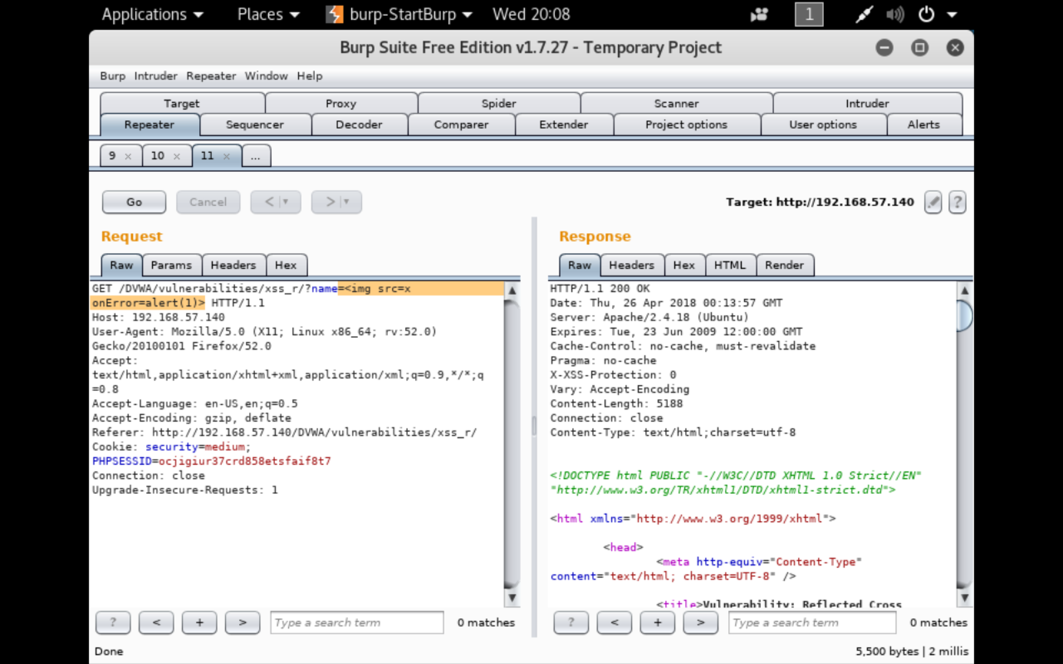
Repeater – updating injected script

Slide 47
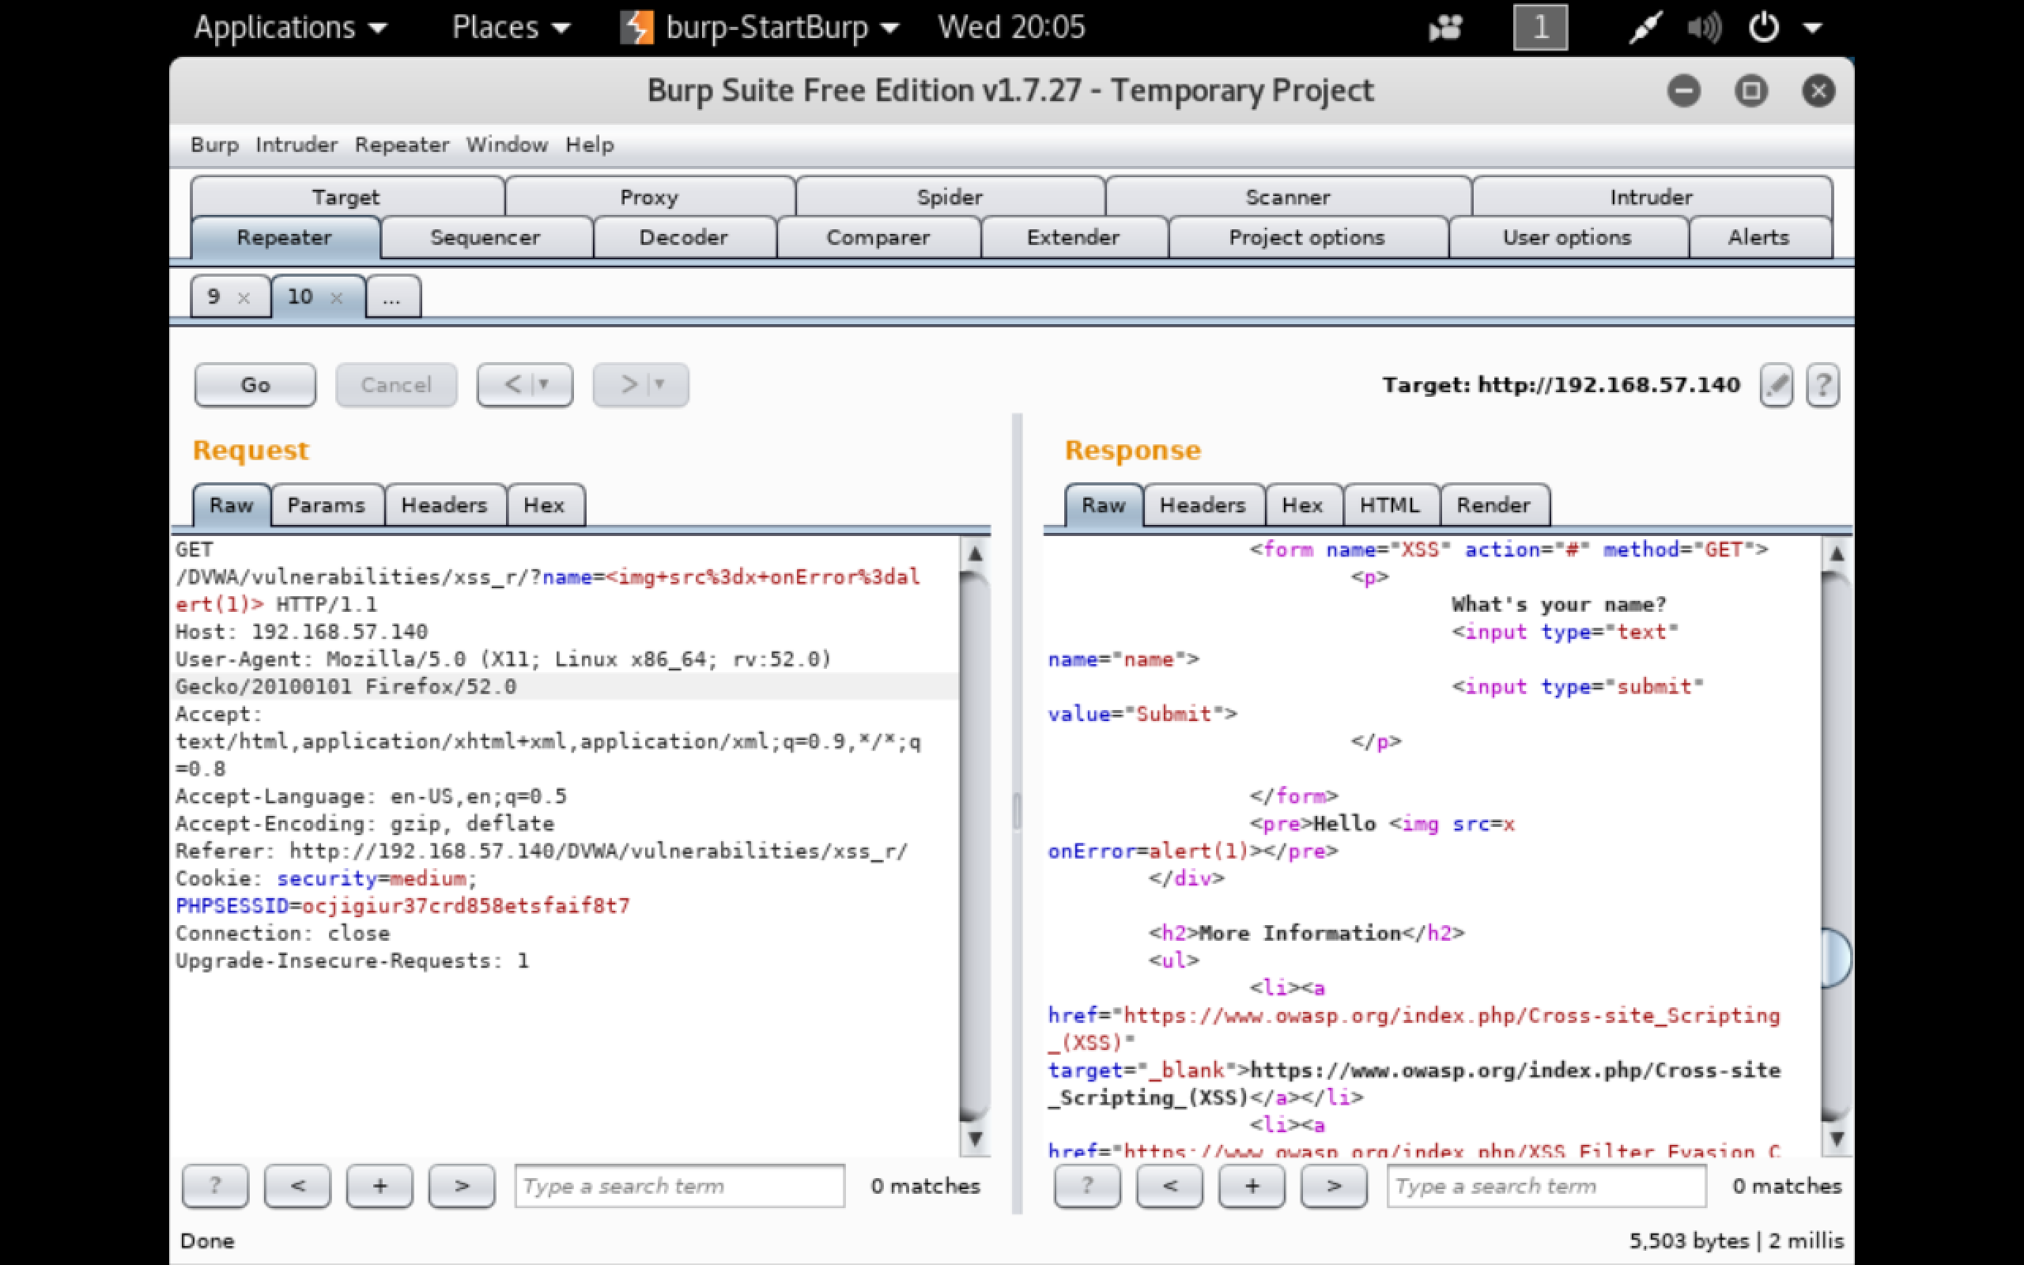
Repeater - encoding inserted script

Slide 48
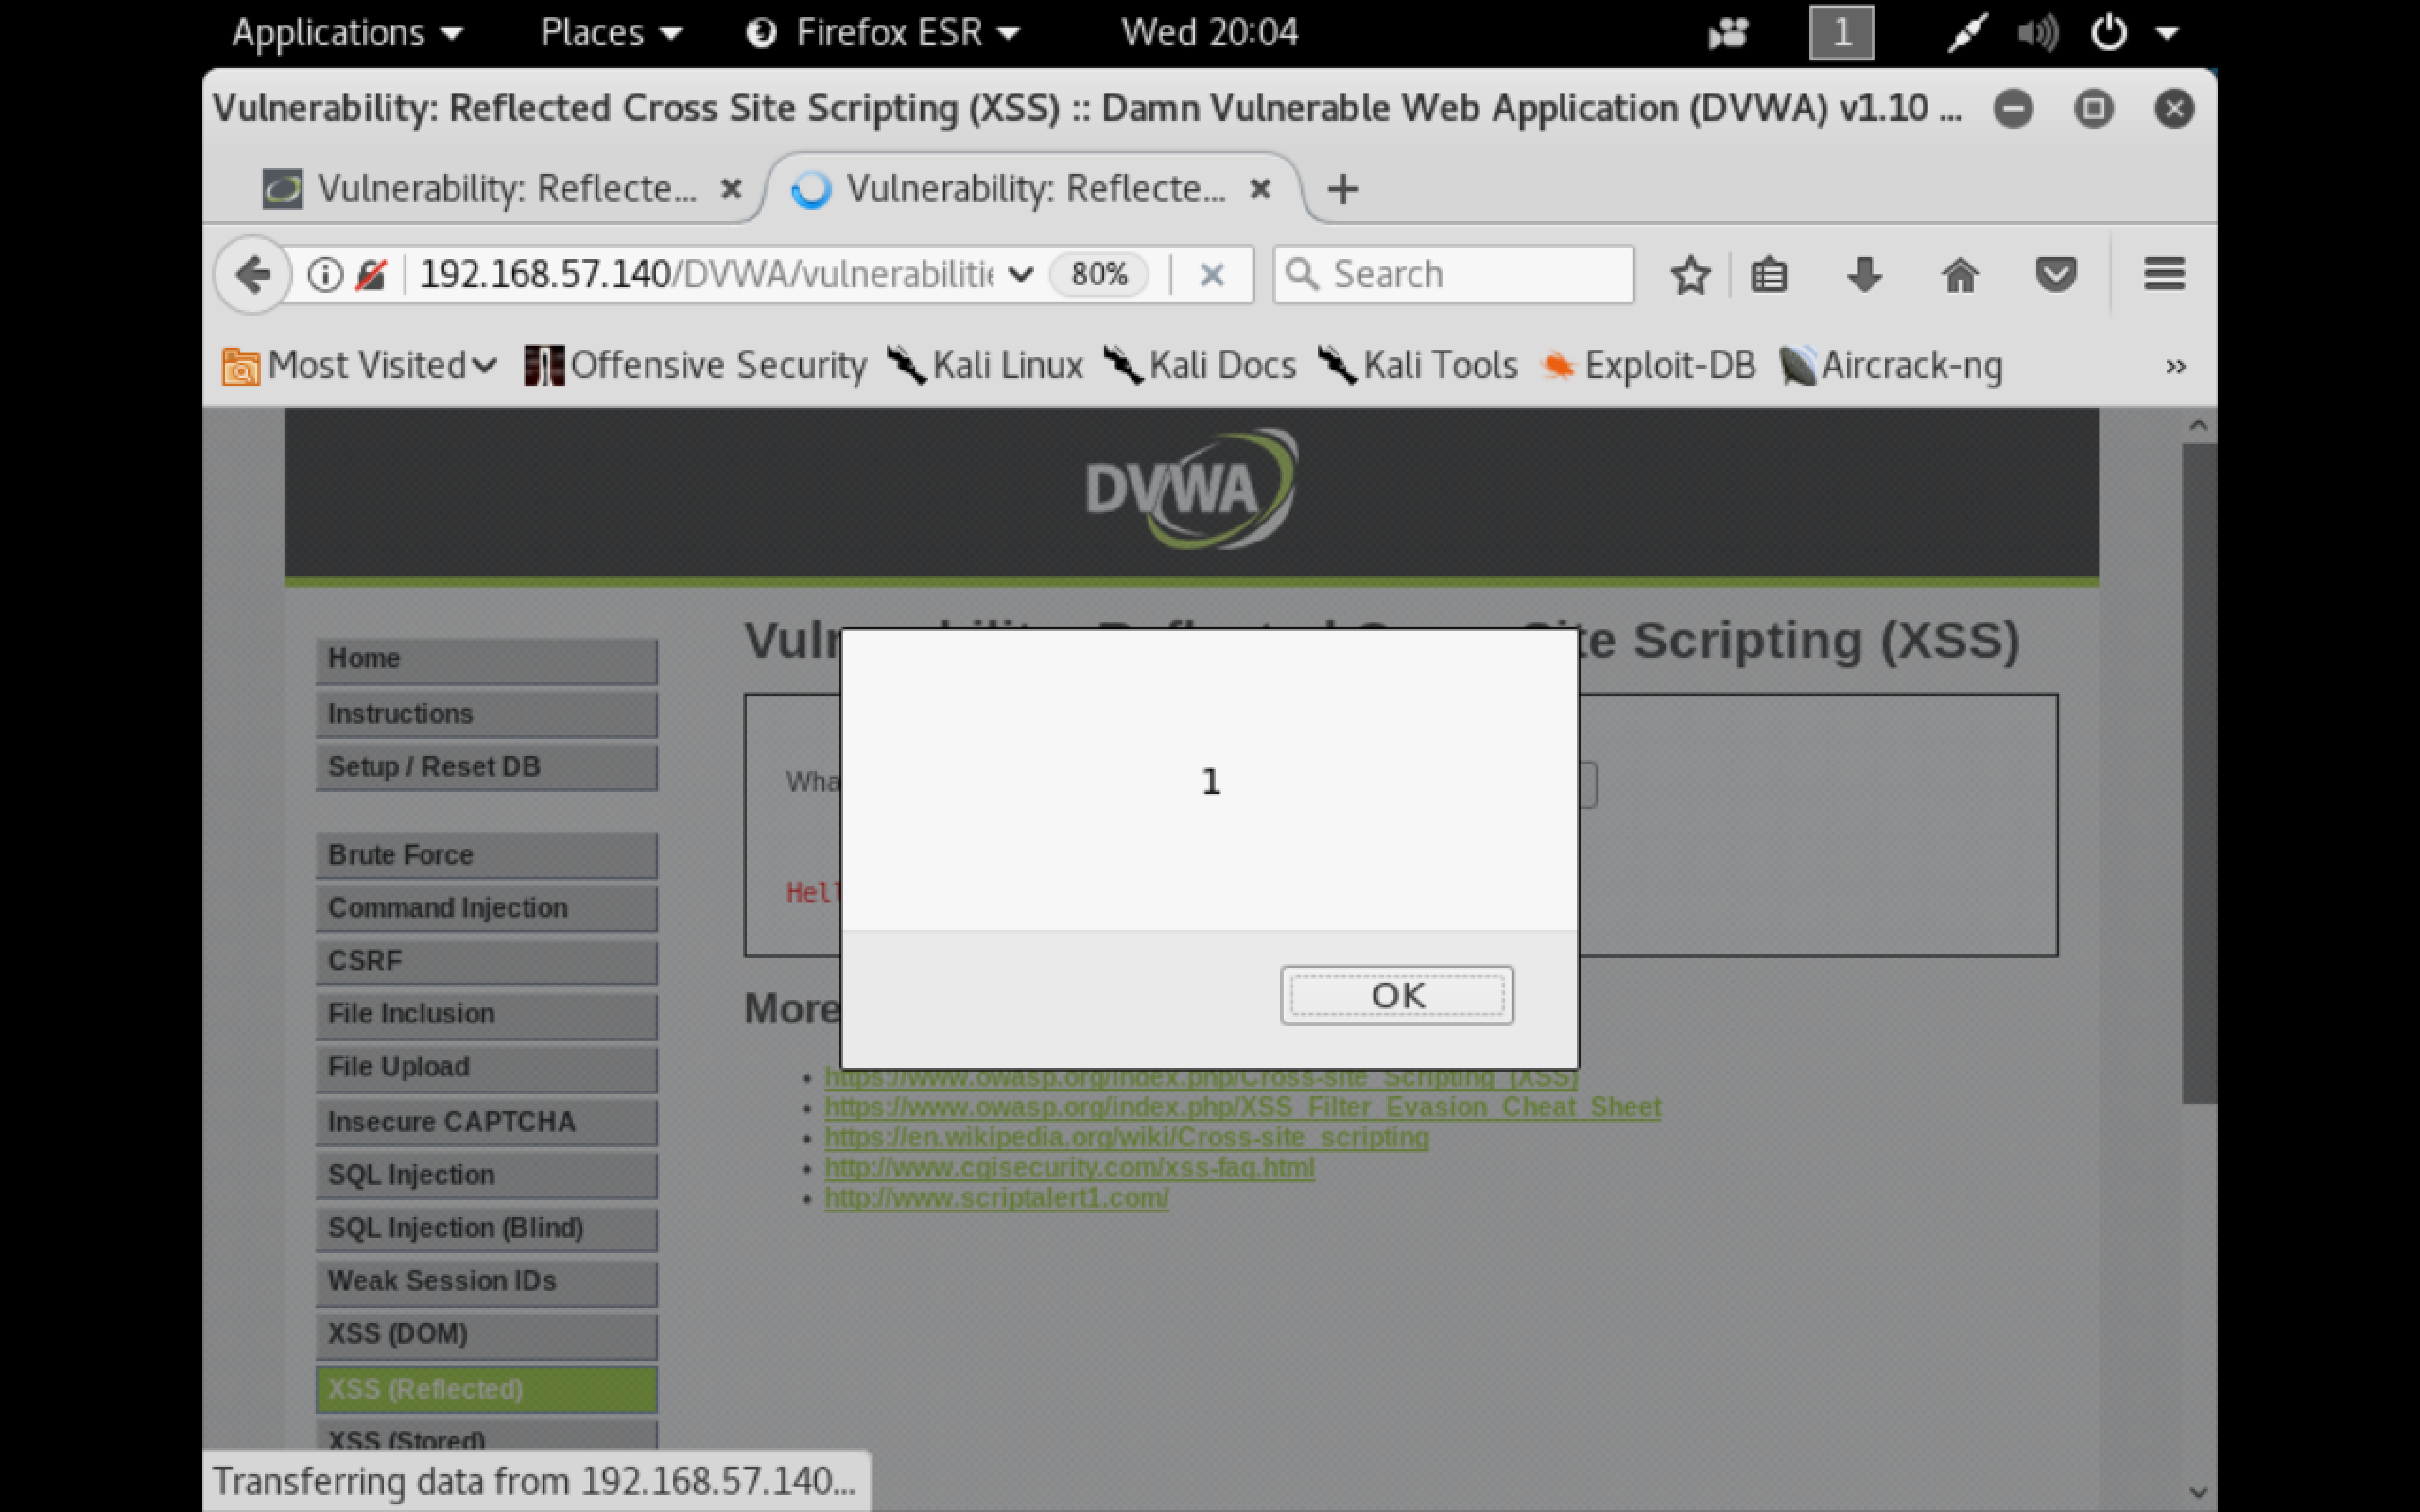
Script was inserted successfully

Slide 49
Use Case 4 File Upload Vulnerability

Slide 50
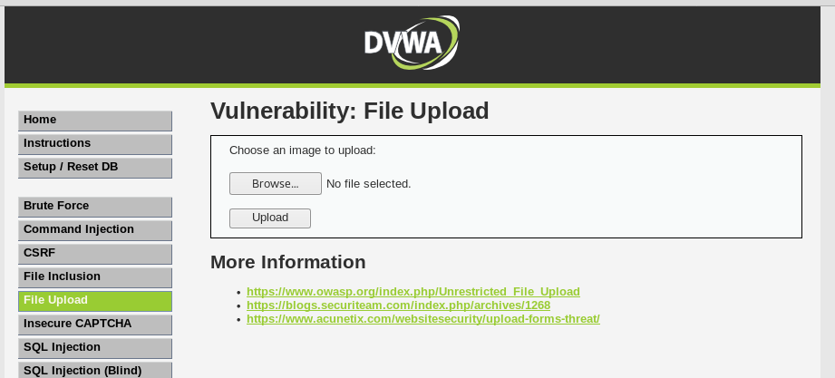
Target Field
Here, DVWA Security level set to Medium and Intercept is ON

Slide 51
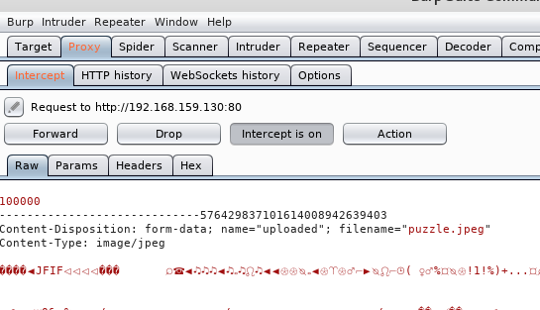
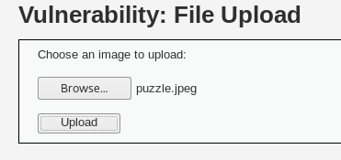
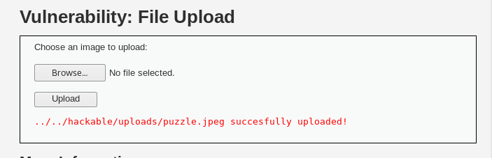
Uploading an Image file
Selecting the File to upload
Request intercepted in Burp
Request is forwarded

Slide 52
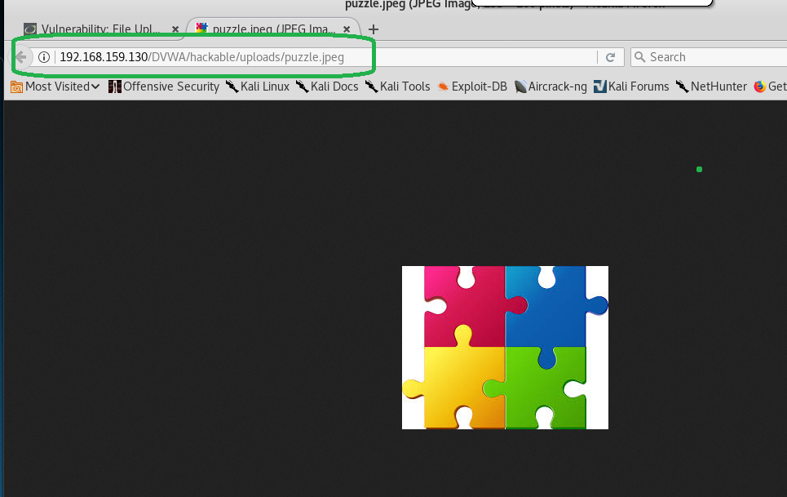
Uploaded image’s location

Slide 53
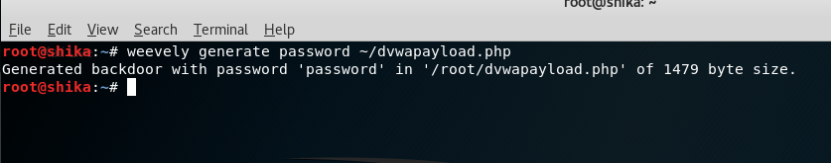
Creating a backdoor payload
Weevely is a tool used to create backdoor payloads
Alternatively, MSFVenom could be used

Slide 54
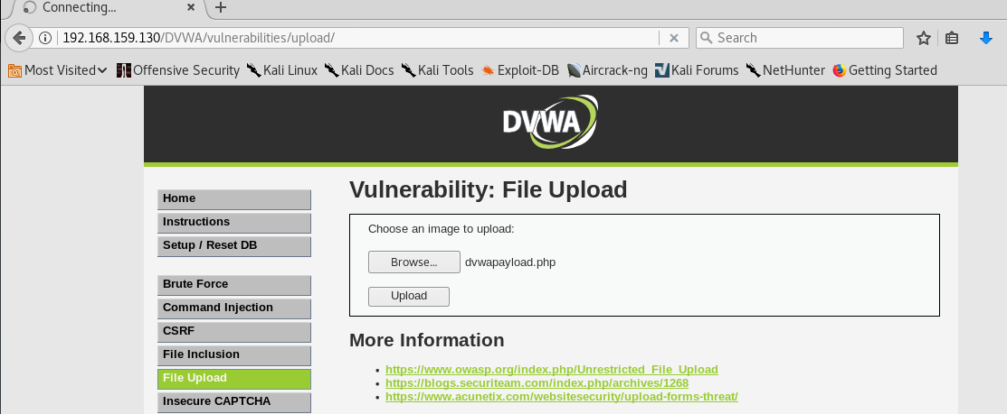
Uploading payload file

Slide 55
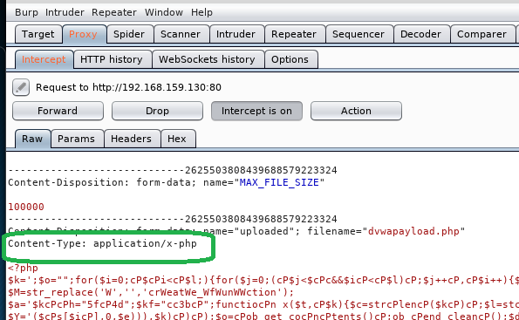
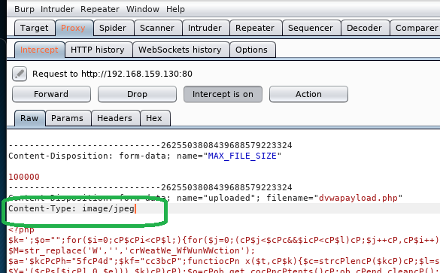
Changing the Content Type
Request is now forwarded

Slide 56
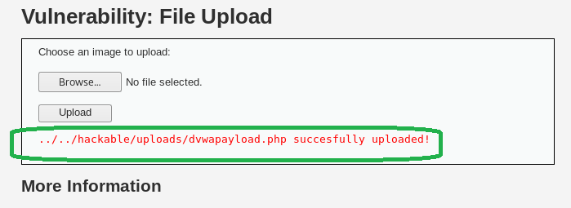
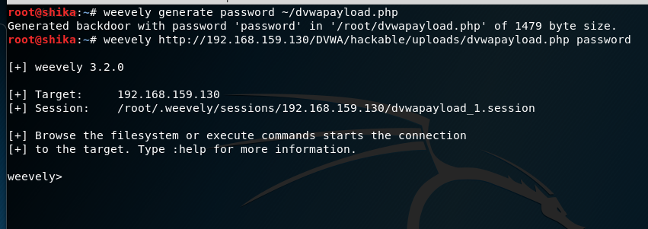
File Uploaded Successfully
We now have access to this box

Slide 57
Burp Suite Editions
Community Editions
Free version
Contains essential manual tools
Professional
Costs $349 per user per year
Contains basic and advanced manual tools
Contains web application vulnerability scanners

Slide 58
Alternatives to Burp Suite
OWASP Zed Attack Proxy
Arachni
Vega
Websecurify
IBM Rational App Scan

Slide 59
SUMMARY OF TABS
Target - This tool contains detailed information about your target applications, and lets you drive the process of testing for vulnerabilities.
Proxy - This is an intercepting web proxy that operates between the end browser and the target web application server. It lets you intercept, inspect and modify the raw traffic passing in both directions.
Spider - This is an intelligent application-aware web spider that can crawl an application to locate its content and functionality.
Scanner - This is a web vulnerability scanner, this automatically discover numerous types of vulnerabilities.
Intruder - This is a powerful tool for carrying out automated customized attacks against web applications. It is highly configurable and can be used to perform a wide range of tasks to make your testing faster and more effective.
Repeater - This is a simple tool for manually manipulating and reissuing individual HTTP requests, and analyzing the application's responses.
Sequencer - This is a tool for analyzing the quality of randomness in an application's session tokens or other important data items that are intended to be unpredictable.
Decoder - This is a useful tool for performing manual or intelligent decoding and encoding of application data.
Comparer - This is a handy utility for performing a visual "diff" between any two items of data, such as pairs of similar HTTP messages.
Extender - This lets you load Burp extensions, to extend Burp's functionality using third-party code.

Slide 60
References
http://resources.infosecinstitute.com/burp-suite-walkthrough/#gref
https://en.wikipedia.org/wiki/Burp_suite
https://portswigger.net/burp/help/suite_gettingstarted
http://resources.infosecinstitute.com/pentesting-mobile-applications-burpsuite/

Slide 61
ANY QUESTIONS?

Slide 62
THANK YOU

